Slide 1

Navigating the Agile Transition: From Waterfall to Adaptive Excellence
Considering the leap from Waterfall to Agile? It's a journey of transformation and growth. This presentation explores key considerations, challenges, and strategies for a successful Agile adoption.
SC
by Srinivasa Chinnappa

Slide 2

Assessing Your Agile Readiness
1
Organizational Flexibility
Evaluate your company's size and adaptability. Agile thrives in flexible environments.
2
Current Agile Progress
Identify where you stand on the Agile journey. Have you taken initial steps?
3
Team Adaptability
Gauge your team's ability to embrace change. Agile requires an open mindset.

Slide 3
Scope of Agile Implementation
Partial Adoption
Full Organization Shift
Implement Agile in specific departments or projects. This allows for controlled experimentation.
Transform the entire company culture. This requires significant commitment but offers comprehensive benefits.

Slide 4

Embracing the Agile Mindset
1
Beyond Process
Understand that Agile is more than procedures. It's a philosophy of adaptability and continuous improvement.
2
Collaborative Culture
Foster open communication and teamwork. Break down silos between departments.
3
Customer-Centric Approach
Prioritize delivering value to customers. Embrace feedback and iterate based on user needs.

Slide 5
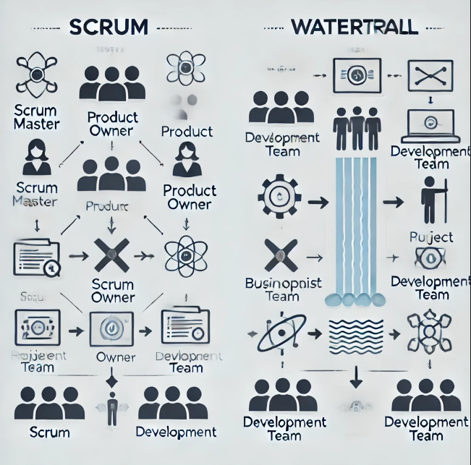
Navigating Role Transitions
Project Manager to Product Owner
Shift focus from task management to product vision and stakeholder communication.
Scrum Master Emergence
Introduce this new role to facilitate Agile processes and remove team obstacles.
Team Member Empowerment
Encourage self-organization and cross-functional skill development within the team.

Slide 6




Overcoming Common Challenges
Trust Building
Foster collaboration between business and development teams through regular interactions and transparency.
Supplier Relations
Adapt external partnerships to fit Agile methodologies. Communicate new expectations clearly.
Governance Concerns
Develop Agile-friendly compliance processes. Balance flexibility with necessary oversight.

Slide 7

Agile Estimation and Planning
Concept
Traditional Approach
Agile Approach
Time Estimation
Hours/Days
Story Points
Planning Horizon
Long-term
Short Sprints
Flexibility
Fixed Scope
Adaptive Planning

Slide 8
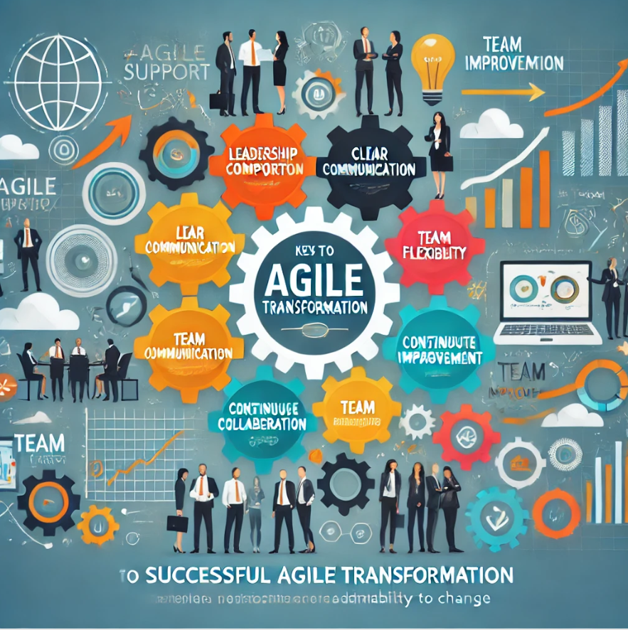



Keys to Successful Agile Transformation
Leadership Support
Secure buy-in from top management. Their commitment drives organizational change.
Continuous Learning
Invest in Agile training and coaching. Knowledge empowers teams to embrace new methodologies.
Patience and Persistence
Understand that transformation takes time. Celebrate small wins and learn from setbacks.

